Slide 1
clustering

Slide 2
Clustering Algorithms
K-means and its variants
What is k-means / algorithm, how to select the initial centroids for k-means (k-means++, bisecting k-means), limitations of k-means (size, density, shape) and the methods to overcome the limitations.
partition based clustering (each cluster / group is not overlapped with any other cluster / group.
Hierarchical clustering
Density-based clustering

Slide 3
Hierarchical Clustering
Produces a set of nested clusters organized as a hierarchical tree
Can be visualized as a dendrogram
A tree like diagram that records the sequences of merges or splits
Notes:
Den_drunk_gram

Slide 4
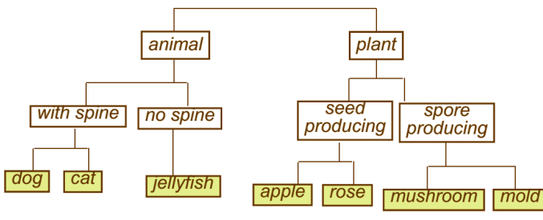


Strengths of Hierarchical Clustering
Do not have to assume any particular number of clusters
Any desired number of clusters can be obtained by ‘cutting’ the dendrogram at the proper level
They may correspond to meaningful taxonomies
Example: biological science
Notes:
all files and folders on the hard disk are organized in hierarchy

Slide 5





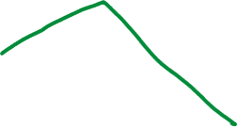




Hierarchical Clustering
Two main types of hierarchical clustering
Agglomerative:
Start with the points as individual clusters
At each step, merge the closest pair of clusters until only one cluster (or k clusters) left
Divisive:
Start with one, all-inclusive cluster
At each step, split a cluster until each cluster contains an individual point (or there are k clusters)
Traditional hierarchical algorithms use a similarity or distance matrix
Merge or split one cluster at a time

Slide 6
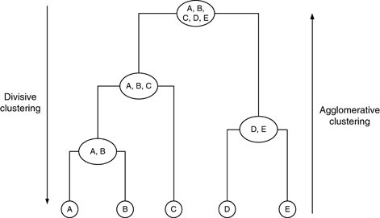
Hierarchical Clustering

Slide 7
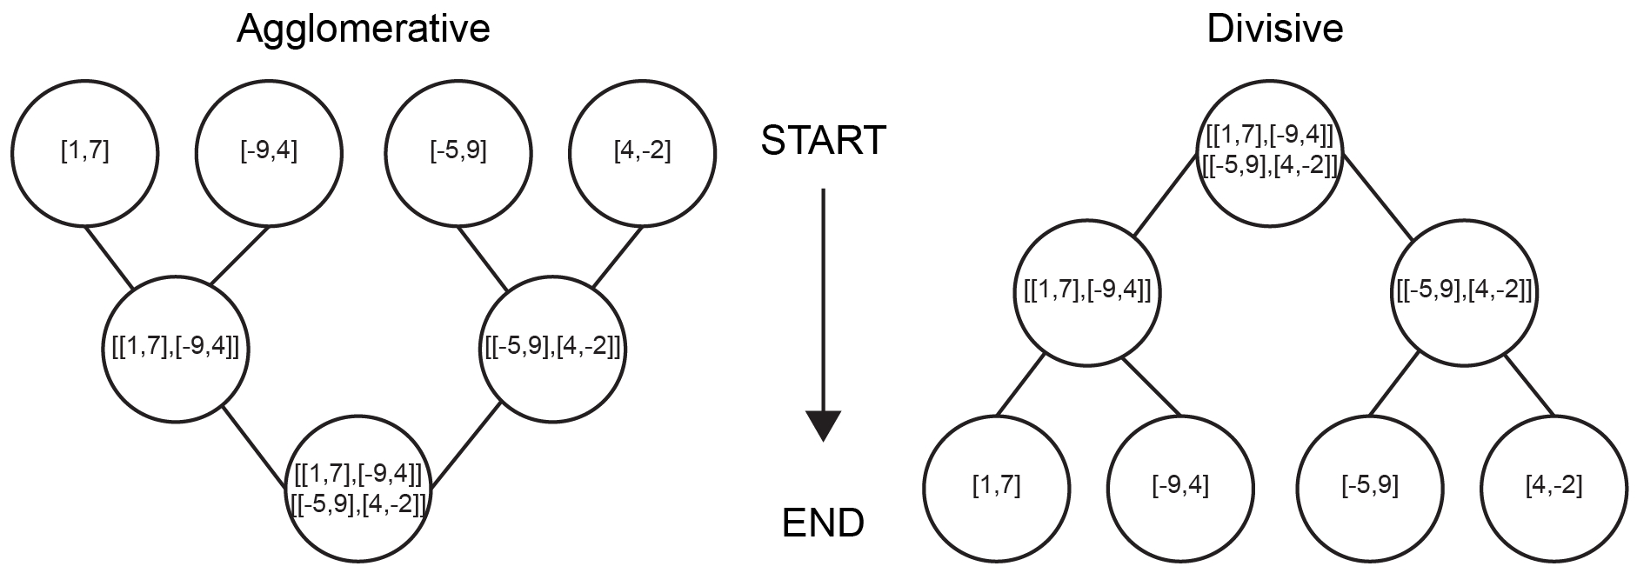
Hierarchical Clustering

Slide 8
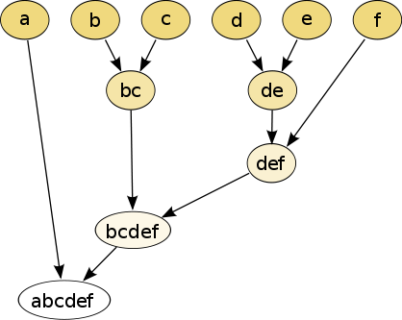
Agglomerative Clustering Algorithm
Key Idea: Successively merge closest clusters
Basic algorithm
Compute the proximity matrix
Let each data point be a cluster
Repeat
Merge the two closest clusters
Update the proximity matrix
Until only a single cluster remains
Key operation is the computation of the proximity of two clusters
Different approaches to defining the distance between clusters distinguish the different algorithms
Notes:
A_gla_ma_ra_tive

Slide 9

Steps 1 and 2
Start with clusters of individual points and a proximity matrix
p1
p2
p3
p4
p5
. . .
p1
p2
p3
p4
p5
.
.
.
Proximity Matrix

Slide 10








Intermediate Situation
C1
C2
C3
C4
C5
After some merging steps, we have some clusters
C1
C2
C3
C3
C4
C4
C5
C1
Proximity Matrix
C2
C5

Slide 11
Step 4
We want to merge the two closest clusters (C2 and C5) and update the proximity matrix.
C1
C2
C3
C4
C5
C1
C3
C2
C4
C3
C4
C1
C5
Proximity Matrix
C2
C5

Slide 12
Step 5
C2 U C5
The question is “How do we update the proximity matrix?”
C1
C3
C4
C1
?
C3
? ? ? ?
C2 U C5
C4
C3
?
C4
?
C1
Proximity Matrix
C2 U C5

Slide 13
How to Define Inter-Cluster Distance
p1
p2
p3
p4
p5
. . .
p1
Similarity?
p2
p3
p4
MIN
MAX
Group Average
Distance Between Centroids
Other methods driven by an objective function
Ward’s Method uses squared error
p5
.
.
.
Proximity Matrix

Slide 14
How to Define Inter-Cluster Similarity
p1
p2
p3
p4
p5
. . .
p1
p2
p3
p4
MIN
MAX
Group Average
Distance Between Centroids
Other methods driven by an objective function
Ward’s Method uses squared error
p5
.
.
.
Proximity Matrix

Slide 15
How to Define Inter-Cluster Similarity
p1
p2
p3
p4
p5
. . .
p1
p2
p3
p4
MIN
MAX
Group Average
Distance Between Centroids
Other methods driven by an objective function
Ward’s Method uses squared error
p5
.
.
.
Proximity Matrix

Slide 16

How to Define Inter-Cluster Similarity
p1
p2
p3
p4
p5
. . .
p1
p2
p3
p4
MIN
MAX
Group Average
Distance Between Centroids
Other methods driven by an objective function
Ward’s Method uses squared error
p5
.
.
.
Proximity Matrix

Slide 17
How to Define Inter-Cluster Similarity
p1
p2
p3
p4
p5
. . .
p1
×
×
p2
p3
p4
MIN
MAX
Group Average
Distance Between Centroids
Other methods driven by an objective function
Ward’s Method uses squared error
p5
.
.
.
Proximity Matrix

Slide 18
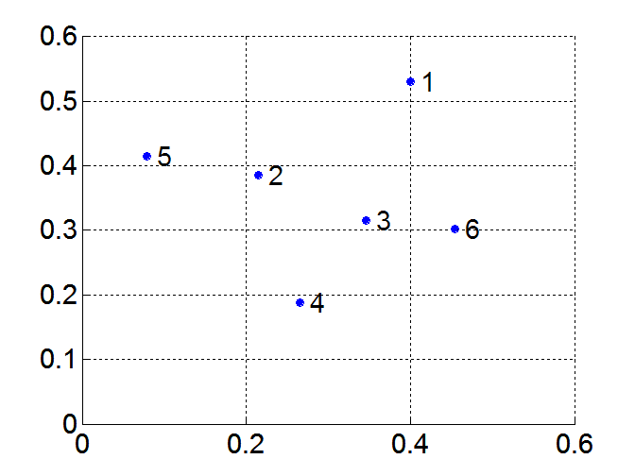
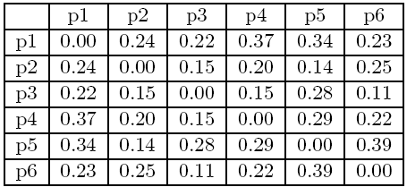



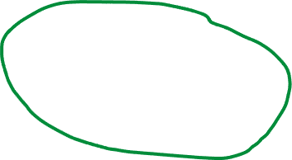

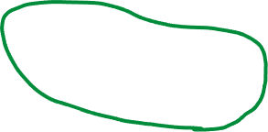




MIN or Single Link
Proximity of two clusters is based on the two closest points in the different clusters
Determined by one pair of points, i.e., by one link in the proximity graph
Example:
Distance Matrix:

Slide 19
Hierarchical Clustering: MIN
5
1
3
5
2
1
2
3
6
4
4
Nested Clusters
Dendrogram

Slide 20
Strength of MIN
Original Points
Six Clusters
Can handle non-elliptical shapes

Slide 21


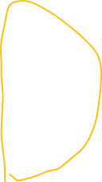
Limitations of MIN
Two Clusters
Original Points
Sensitive to noise
Three Clusters

Slide 22


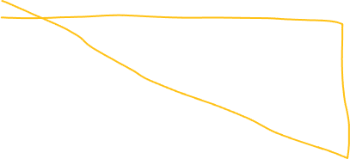
MAX or Complete Linkage
Proximity of two clusters is based on the two most distant points in the different clusters
Determined by all pairs of points in the two clusters
Distance Matrix:

Slide 23
Hierarchical Clustering: MAX
4
1
2
5
5
2
3
6
3
1
4
Nested Clusters
Dendrogram

Slide 24
Strength of MAX
Original Points
Two Clusters
Less susceptible to noise

Slide 25
Limitations of MAX
Original Points
Two Clusters
Tends to break large clusters
Biased towards globular clusters

Slide 26
Group Average
Proximity of two clusters is the average of pairwise proximity between points in the two clusters.
Distance Matrix:

Slide 27
Hierarchical Clustering: Group Average
5
4
1
2
5
2
3
6
1
4
3
Nested Clusters
Dendrogram

Slide 28

Hierarchical Clustering: Group Average
Compromise between Single and Complete Link
Strengths
Less susceptible to noise
Limitations
Biased towards globular clusters

Slide 29
Cluster Similarity: Ward’s Method
Similarity of two clusters is based on the increase in squared error when two clusters are merged
Similar to group average if distance between points is distance squared
Less susceptible to noise
Biased towards globular clusters
Hierarchical analogue of K-means
Can be used to initialize K-means

Slide 30
Hierarchical Clustering: Comparison
5
4
1
1
3
2
5
5
5
2
2
1
MAX
MIN
3
2
3
6
3
6
1
4
4
4
5
5
4
1
1
2
2
Ward’s Method
5
5
2
2
Group Average
3
6
3
6
1
3
1
4
4
4
3

